Slide 1

VDT Learning Management System Awareness

Slide 2
VDT Learning Management System Awareness Training
Presented By: INFORMATION TECHNOLOGY DEPARTMENT

Slide 3
INTRODUCTION
As the workload of employees increases and their schedules become even tighter, it is crucial for any organization that wants to increase its staffs level of efficiency to invest in virtual learning management system as a means of training its staff.

Slide 4
A virtual learning environment (VLE) is a set of teaching and learning tools designed to enhance a student's learning experience by including computers and the Internet in the learning process. Some examples of virtual learning environment include Moodle, blackboard, Frog, Fronter, Kaleidos, Elluminate, Ilias, Smartschool, etc

Slide 5
Major Components
The principal components of a VLE package include:
curriculum mapping (breaking curriculum into sections that can be assigned and assessed)
student tracking, online support for both teacher and student
electronic communication (e-mail, threaded discussions, chat, Web publishing)
and Internet links to outside curriculum resources.

Slide 6
HOW VLEs ARE STRUCTURED FOR USE
In general, VLE users are assigned either a teacher ID or a student ID. The teacher sees what a students sees, but the teacher has additional user rights to create or modify curriculum content and track student performance.

Slide 7
Introduction to Moodle as a VLE system
Moodle (acronym for modular object-oriented dynamic learning environment) is a highly flexible, free software, open source learning platform. With comprehensive, customizable and secure learning management features, it can be used to create a private website for dynamic online courses.

Slide 8
What Makes Moodle Thick?
By 31 August 2011:
Moodle had a user-base of 55,110 registered sites with 44,966,541 users in 4,763,446 courses in 214 countries and in more than 75 languages.
The site with the most users, moodle.org, has 66 courses and 1,090,234 users. Following a £5 million investment in 2005, The Open University, UK is the second-largest Moodle deployment by user-base, with 714,310 users and 6,093 courses. A comprehensive list of the top ten Moodle sites (by courses and by users) is maintained at moodle.org.
By 31 August 2014:
Moodle had a user-base of 88,070 registered sites with 76,675,352 users in 8,324,096 courses in 241 countries.
Source - Wikipaedia

Slide 9
E-learning Standards Compliance!
Moodle has adopted a number of e-learning standards.
Sharable Content Object Reference Model (SCORM) is a collection of e-learning standards and specifications that define communications between client side content and a server side learning management system, as well as how externally authored content should be packaged in order to integrate with the LMS effectively.
There are two versions: SCORM 1.2 and SCORM 2004. Moodle is SCORM 1.2 compliant, and passes all the tests in the ADL Conformance test suite 1.2.7 for SCORM 1.2. SCORM 2004 is not supported in Moodle.
The AICC HACP standard for CMI was developed by the Aviation Industry Computer-Based Training Committee (AICC) and is used to call externally authored content and assessment packages. AICC content packages are supported in Moodle 2.1 and later versions.
IMS Content Packages can also be imported into Moodle. In addition, Moodle Book activities can be exported as IMS Content Packages.
Learning Tools Interoperability (LTI) is a standard way of integrating rich learning applications (often remotely hosted and provided through third-party services) with educational platforms. Moodle uses the External Tool activity to act as an 'LTI consumer' as standard, and will act as an 'LTI provider' using a plugin.
Source - Wikipaedia

Slide 10
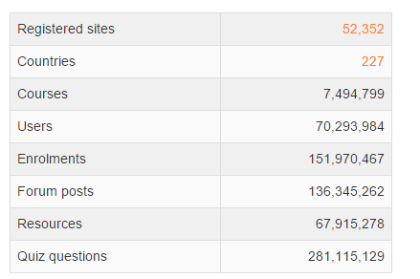
Moodle Registered Sites and List of Countries!

Slide 11
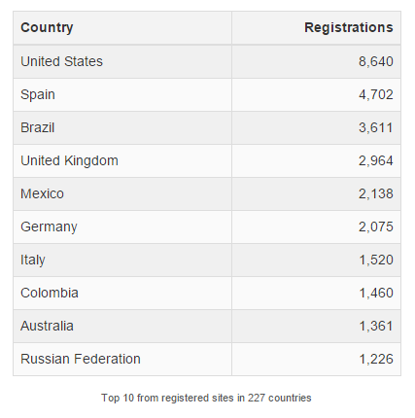
Moodle Top 10 Countries By Registration

Slide 12
Moodle Certifications
Since 2006 there has been an official certification available for teachers using Moodle. Initially called the Moodle Teacher Certificate (MTC), this was renamed in 2008 to the Moodle Course Creator Certificate (MCCC). MCCC is available only through Moodle Partners, and through Central Certification Services. Discussion is ongoing regarding an official Moodle Administrators Certificate.

Slide 13
Who Uses Moodle?
Moodle is used by a variety of institutions and individuals, including:
Universities
High schools
Primary schools
Government departments
Healthcare organizations
Military organizations
Airlines
Oil & Gas companies
Homeschoolers
Independent educators
special educators

Slide 14
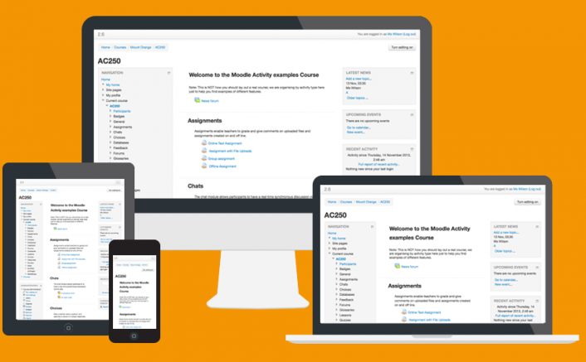
Why Moodle (Features)?
Modern, easy to use interface - Designed to be responsive and accessible, the Moodle interface is easy to navigate on both desktop and mobile devices.

Slide 15
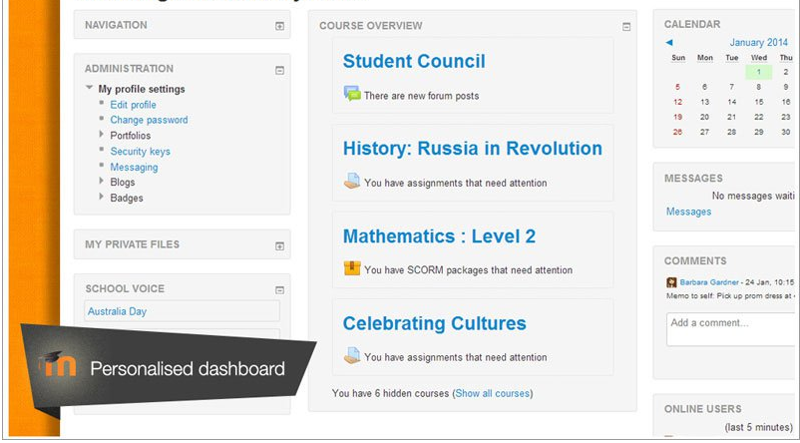
…continuation
Personalized Dashboard - Organize and display courses the way you want, and view at a glance current tasks and messages.

Slide 16
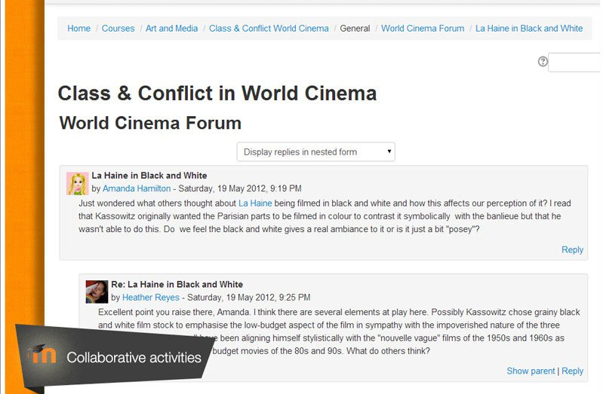
…continuation
Collaborative tools and activities - Work and learn together in forums, wikis, glossaries, database activities, and much more.

Slide 17
…continuation
Collaborative tools and activities - Work and learn together in forums, wikis, glossaries, database activities, and much more.

Slide 18
List of Moodle Activities
Assignments - Enable teachers to grade and give comments on uploaded files and assignments created on and off line
Chat - Allows participants to have a real-time synchronous discussion
Choice - A teacher asks a question and specifies a choice of multiple responses
Database - Enables participants to create, maintain and search a bank of record entries
External tool - Allows participants to interact with Learning Tools Interoperability (LTI) compliant learning resources and other activities on other web site
Feedback - For creating and conducting surveys to collect feedback
Forum - Allows participants to have asynchronous discussions
Glossary - Enables participants to create and maintain a list of definitions, like a dictionary
Lesson - For delivering content in flexible ways
Quiz - Allows the teacher to design and set quiz tests, which may be automatically marked and feedback and/or to correct answers shown
SCORM - Enables SCORM packages to be included as course content
Survey - For gathering data from students to help teachers learn about their classes and reflect on their own teaching
Wiki - A collection of web pages that anyone can add to or edit
Workshop - Enables peer assessment

Slide 19
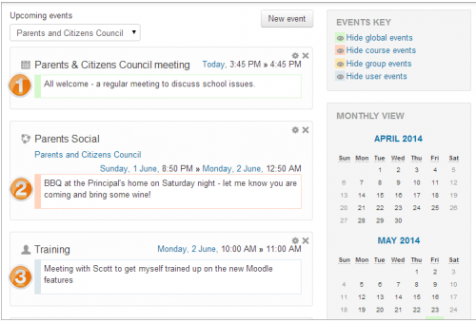
…continuation
All-in-one calendar - Moodle’s calendar tool helps you keep track of your academic or company calendar, course deadlines, group meetings, and other personal events.

Slide 20
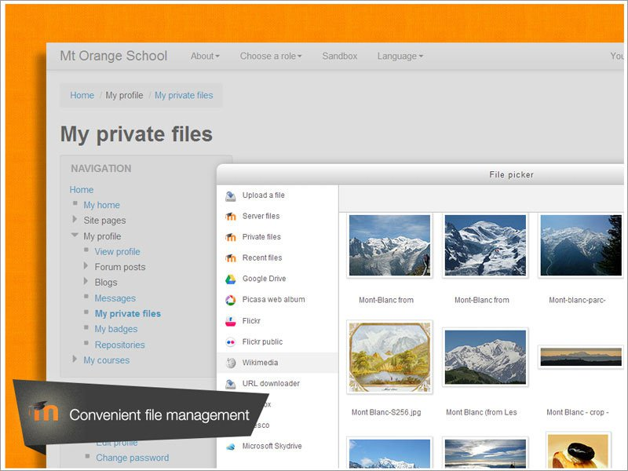
…continuation
Convenient file management - Drag and drop files from cloud storage services including MS Skydrive, dropbox and Google Drive.

Slide 21
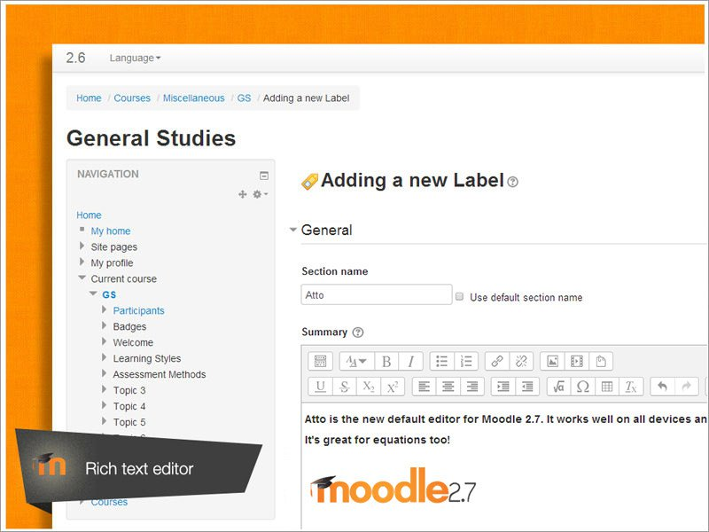
…continuation
Simple and intuitive text editor - Format text and conveniently add media and images with an editor that works across all web browsers and devices.

Slide 22
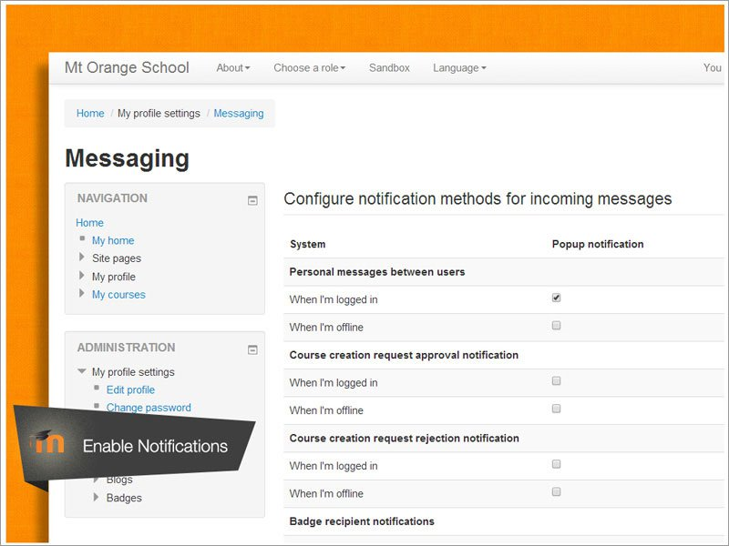
…continuation
Notifications/Messaging - "Messaging" refers both to automatic alerts from Moodle about new forum posts, assignment submission, notifications, etc. and also conversations using the instant messaging feature.

Slide 23
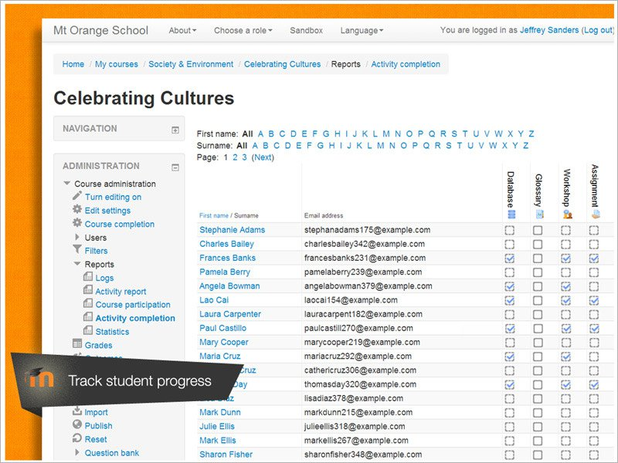
…continuation
Track student progress - Educators and learners can track progress and completion with an array of options for tracking individual activities or resources and at course level.

Slide 24
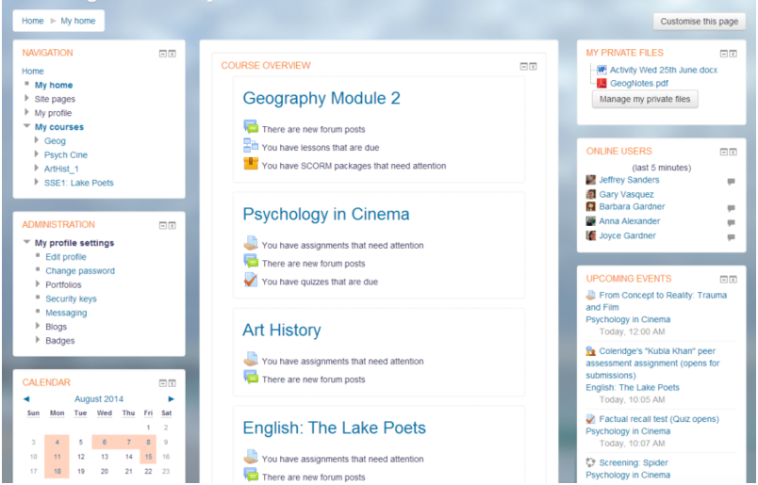
Graphical Representation of a Moodle Site

Slide 25


